Slide 1

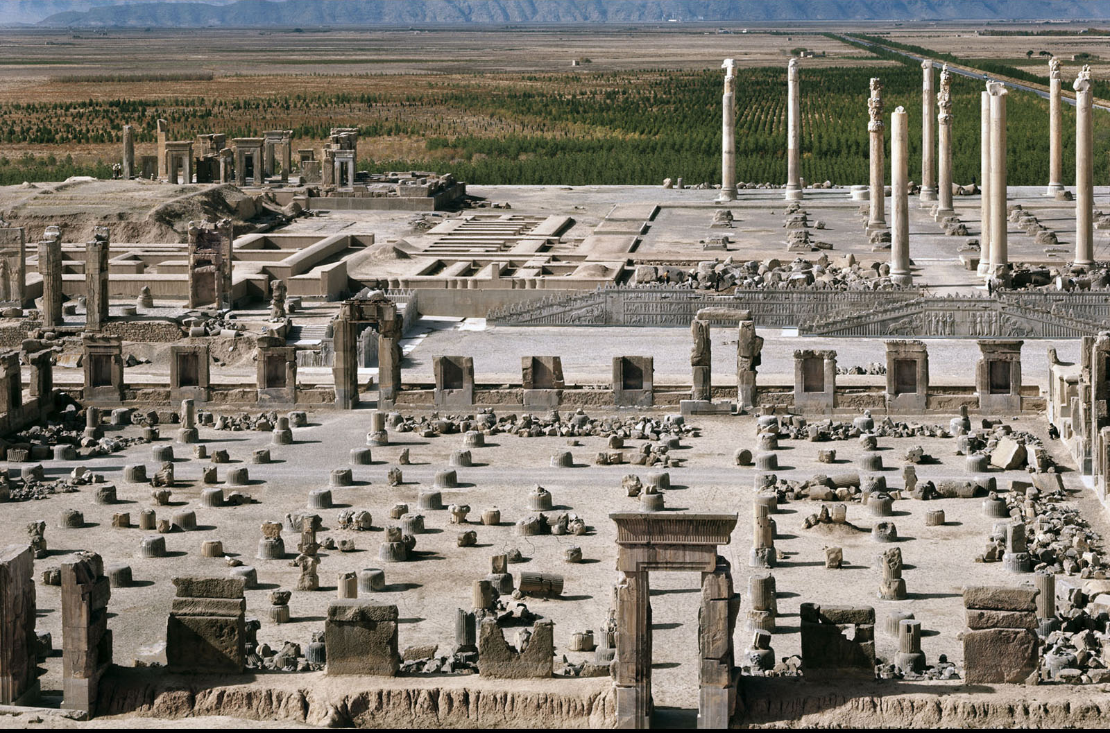
HOMEWORK:
How does the layout and decoration of great palace complexes express the power of Assyrian (Palace Complex of Sargon II) or Persian (Palace of Darius and Xerxes) rulers?
1 to 2 paragraphs hand written
Lamassu, from the the Palace Complex of Sargon II, Assyrian (left)
Palace of Darius and XerxesLamassu, from the the Palace Complex of Sargon II, Assyrian (left)
Palace of Darius and Xerxes, Persepolis, Persian (rig, Persepolis, Persian (right)
Lamassu, from the the Palace Complex of Sargon II, Assyrian (left)
Palace of Darius and Xerxes, Persepolis, Persian (right)
Notes:
1
Figure 2.20

